Slide 1











From Multi-crop teacher to Single-crop student via Knowledge Distillation
Page 01
Presented By
Aniruddh jain - U22CS088 Nikhil tiwari - U22CS091 Saud masaud alam - U22CS094
Mahek Patel - U22CS103
Project Guide - Dr. Sourajit Behera

Slide 2
Problem Statement
Page 02
Context: Farmers face significant crop losses due to late or incorrect identification of plant diseases.
The Problem: Manual detection is time-consuming, requires expertise, and is prone to error.
Impact: Leads to reduced crop yield, economic losses, and poor-qualit produce.
The Need: An automated, reliable, and accurate plant disease detection system using deep learning.

Slide 3







Motivation & Project Goals
Page 03
Motivation: Early disease detection can save crops, reduce pesticide use, and improve productivity.
Opportunity: Advances in computer vision and transfer learning enable effective solutions with limited data.
Achieve high classification accuracy (>90%).
Optimize model size with quantization for real-world deployment.
Improve model efficiency using Knowledge Distillation (KD) to create a faster lightweight student model for deployment.

Slide 4
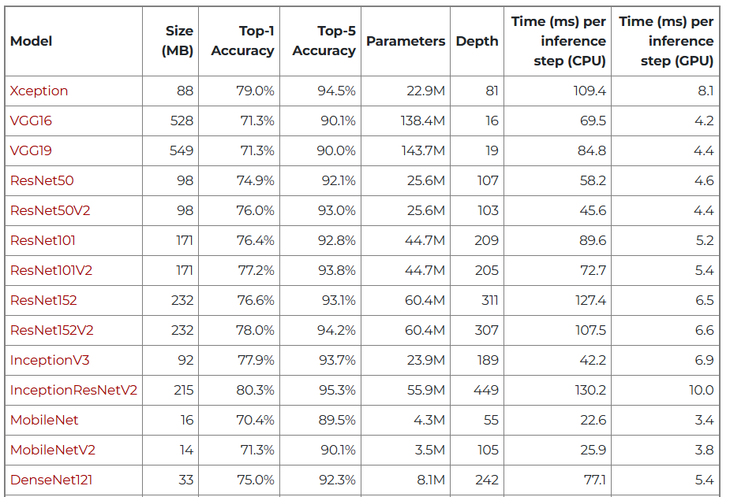

Literature Survey
Page 04
Existing Methods: VGG16/VGG19: Good accuracy but computationally heavy.
ResNet: Strong feature extraction but slower training. MobileNet/Lightweight CNNs: Faster but lower accuracy. Limitations: High computational cost.
Research Gap: Need a lightweight yet accurate model that works well on real-world plant images.
https://keras.io/api/applications/

Slide 5
Proposed Methodology
Page 05
Core Idea: Leverage transfer learning and knowledge distillation by fine-tuning Xception on the PlantDoc dataset and transferring its learned representations to a lightweight MobileNetV2 student model. The pipeline is supported with data augmentation, class balancing, and model quantization for real-world deployment.
Technologies Used: Python, TensorFlow/Keras, Scikit-learn, Matplotlib.

Slide 6
Proposed Methodology
Page 06
Key Features :
Transfer Learning from ImageNet using Xception as the teacher model
Knowledge Distillation to train MobileNetV2 as an efficient student model
Data Augmentation and class weights to handle dataset imbalance
Model Quantization (FP32 → INT8) for reduced size and faster inference

Slide 7
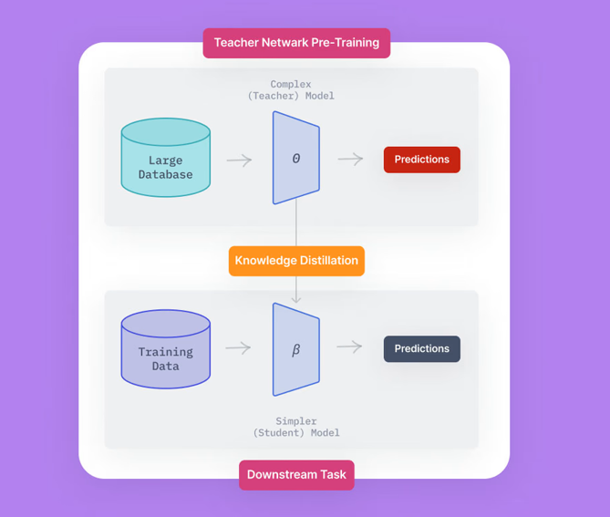
Knowledge Distillation (KD) in Our Model
Page 07
Knowledge Distillation : A model compression technique where a large, accurate model (Teacher) transfers its knowledge to a smaller, faster model (Student)
Helps reduce model size and inference time without significant accuracy loss

Slide 8
System Architecture / Pipeline
Page 08
Input: PlantDoc leaf images and PlantVillage Potato Subset images
Preprocessing: Resizing, normalization, augmentation.
Model Training:
Teacher model: Xception other Models listed with fine-tuning .
Student Model : MobilenetV2
Evaluation: Accuracy, F1, AUC, Cohen’s Kappa.
Output: Predicted plant disease class.

Slide 9
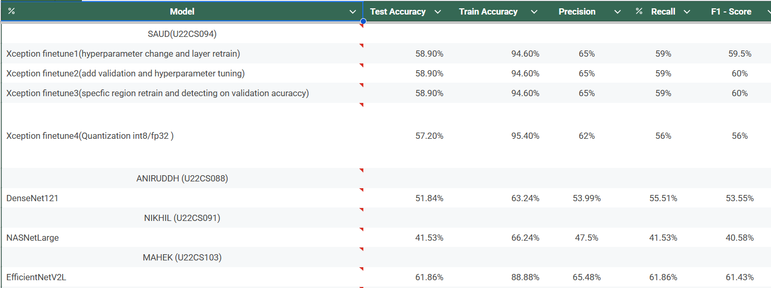





Initial Experimental Results
Page 09

Slide 10
Implementation & Training Details
Page 10
Environment: Hardware: NVIDIA GPU (Colab environment).
Software: TensorFlow, Keras, Python.
Training Parameters: Epochs: 20-30
Batch Size: 32
Learning Rate: 1e-3 (warm-up), reduced for fine-tuning.
Evaluation Metrics: Accuracy, F1-Score, Cohen’s Kappa, AUC.

Slide 11
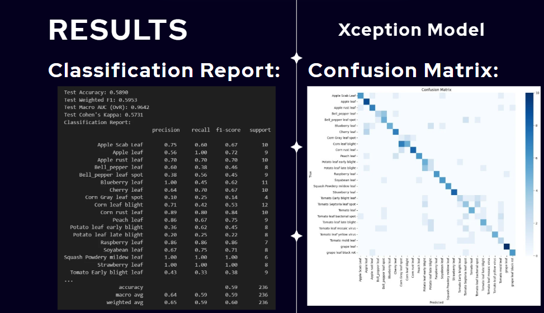
Page 11

Slide 12
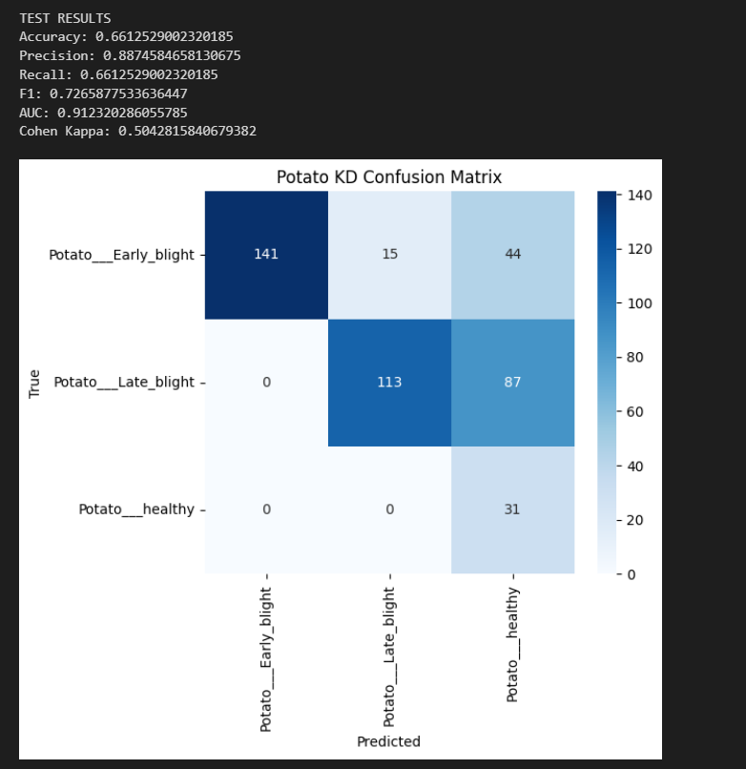
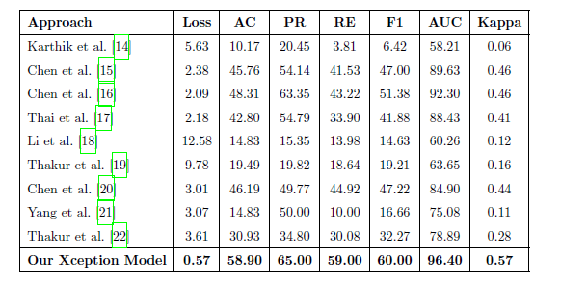
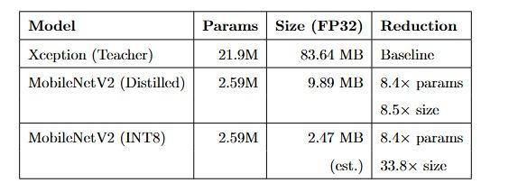
RESULTS
Page 12
Comparative Analysis with Existing Methods(Xception) :
Test Results For Student Model :
Efficiency and Deployment Metrics :

Slide 13
Conclusion
Summary of Findings: Successfully applied deep learning to detect plant diseases with high accuracy.
Implemented Knowledge Distillation→MobileNetV2
Student model achieved near-teacher performance
Problem Revisited: Automated system reduces reliance on manual inspection.
Challenges Faced: Data imbalance, runtime interruptions, model overfitting.

Slide 14
Thank You

